Slide 1
Zynq Architecture
Zynq
Vivado 2014.2 Version

Slide 2
Objectives
After completing this module, you will be able to:
Identify the basic building blocks of the Zynq™ architecture processing system (PS)
Describe the usage of the Cortex-A9 processor memory space
Connect the PS to the programmable logic (PL) through the AXI ports
Generate clocking sources for the PL peripherals
List the various AXI-based system architectural models
Name the five AXI channels
Describe the operation of the AXI streaming protocol

Slide 3
Outline
Zynq All Programmable SoC (AP SoC)
Zynq AP SoC Processing System (PS)
Processor Peripherals
Clock, Reset, and Debug Features
AXI Interfaces
Summary

Slide 4
The PS and the PL
The Zynq-7000 AP SoC architecture consists of two major sections
PS: Processing system
Dual ARM Cortex-A9 processor based
Multiple peripherals
Hard silicon core
PL: Programmable logic
Shares the same 7 series programmable logic as
Artix™-based devices: Z-7010, Z-7015, and Z-7020 (high-range I/O banks only)
Kintex™-based devices: Z-7030, Z-7045, and Z-7100 (mix of high-range and high-performance I/O banks)
This sections focuses on the PS

Slide 5
Zynq-7000 Family Highlights
Complete ARM®-based processing system
Application Processor Unit (APU)
Dual ARM Cortex™-A9 processors
Caches and support blocks
Fully integrated memory controllers
I/O peripherals
Tightly integrated programmable logic
Used to extend the processing system
Scalable density and performance
Flexible array of I/O
Wide range of external multi-standard I/O
High-performance integrated serial transceivers
Analog-to-digital converter inputs

Slide 6
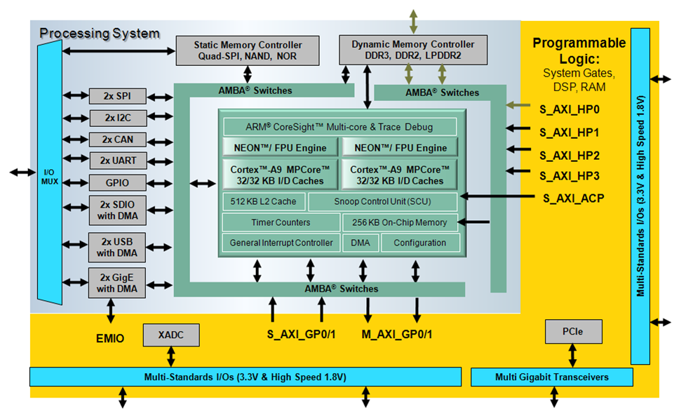
Zynq-7000 AP SoC Block Diagram

Slide 7
PS Components
Application processing unit (APU)
I/O peripherals (IOP)
Multiplexed I/O (MIO), extended multiplexed I/O (EMIO)
Memory interfaces
PS interconnect
DMA
Timers
Public and private
General interrupt controller (GIC)
On-chip memory (OCM): RAM
Debug controller: CoreSight

Slide 8
Outline
Zynq All Programmable SoC (AP SoC)
Zynq AP SoC Processing System (PS)
Processor Peripherals
Clock, Reset, and Debug Features
AXI Interfaces
Summary

Slide 9
ARM Processor Architecture
ARM Cortex-A9 processor implements the ARMv7-A architecture
ARMv7 is the ARM Instruction Set Architecture (ISA)
ARMv7-A: Application set that includes support for a Memory Management Unit (MMU)
ARMv7-R: Real-time set that includes support for a Memory Protection Unit (MPU)
ARMv7-M: Microcontroller set that is the smallest set
The ARMv7 ISA includes the following types of instructions (for backwards compatibility)
Thumb instructions: 16 bits; Thumb-2 instructions: 32 bits
NEON: ARM’s Single Instruction Multiple Data (SIMD) instructions
ARM Advanced Microcontroller Bus Architecture (AMBA®) protocol
AXI3: Third-generation ARM interface
AXI4: Adding to the existing AXI definition (extended bursts, subsets)
Cortex is the new family of processors
ARM family is older generation; Cortex is current; MMUs in Cortex processors and MPUs in ARM

Slide 10
ARM Cortex-A9 Processor Power
Dual-core processor cluster
2.5 DMIP/MHz per processor
Harvard architecture
Self-contained 32KB L1 caches for instructions and data
External memory based 512KB L2 cache
Automatic cache coherency between processor cores
1GHz operation (fastest speed grade)

Slide 11
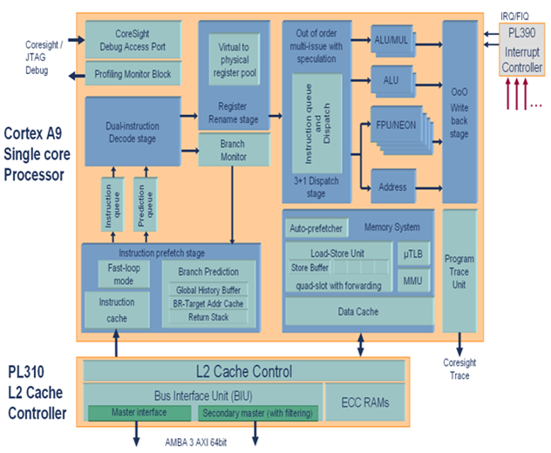
ARM Cortex-A9 Processor Micro-Architecture
Instruction pipeline supports out-of-order instruction issue and completion
Register renaming to enable execution speculation
Non-blocking memory system with load-store forwarding
Fast loop mode in instruction pre-fetch to lower power consumption
Notes:
Load store – store buffered to memory, load reads from same address. Data in memory is stale. To prevent a stall, the stored buffer can be forwarded to the load

Slide 12
ARM Cortex-A9 Processor Micro-Architecture
Variable length, out-of-order, eight-stage, super-scalar instruction pipeline
Advanced pre-fetch with parallel branch pipeline enabling early branch prediction and resolution
Multi-issued into
Primary data processing pipeline
Secondary full data processing pipeline
Load-store pipeline
Compute engine (FPU/NEON) pipeline
Speculative execution
Supports virtual renaming of ARM physical registers to remove pipeline stalls due to data dependencies
Increased processor utilization and hiding of memory latencies
Increased performance by hardware unrolling of code loops
Reduced interrupt latency via speculative entry to Interrupt Service Routine (ISR)

Slide 13
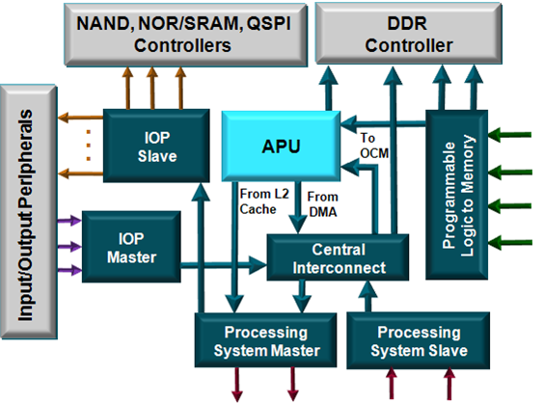
Processing System Interconnect (1)
Programmable logic to memory
Two ports to DDR
One port to OCM SRAM
Central interconnect
Enables other interconnects to communicate
Peripheral master
USB, GigE, SDIO connects to DDR and PL via the central interconnect
Peripheral slave
CPU, DMA, and PL access to IOP peripherals

Slide 14
Processing System Interconnect (2)
Processing system master
Two ports from the processing system to programmable logic
Connects the CPU block to common peripherals through the central interconnect
Processing system slave
Two ports from programmable logic to the processing system

Slide 15
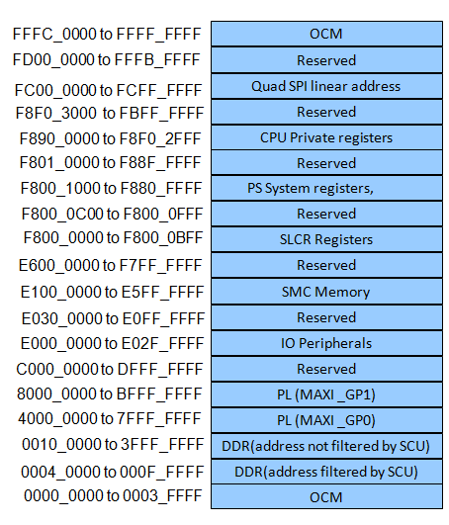
Memory Map
The Cortex-A9 processor uses 32-bit addressing
All PS peripherals and PL peripherals are memory mapped to the Cortex-A9 processor cores
All slave PL peripherals will be located between 4000_0000 and 7FFF_FFFF (connected to GP0) and 8000_0000 and BFFF_FFFF (connected to GP1)

Slide 16
Zynq AP SoC Memory Resources
On-chip memory (OCM)
RAM
Boot ROM
DDRx dynamic memory controller
Supports LPDDR2, DDR2, DDR3
Flash/static, memory controller
Supports SRAM, QSPI, NAND/NOR FLASH

Slide 17
PS Boots First
CPU0 boots from OCM ROM; CPU1 goes into a sleep state
On-chip boot loader in OCM ROM (Stage 0 boot)
Processor loads First Stage Boot Loader (FSBL) from external flash memory
NOR
NAND
Quad-SPI
SD Card
Load from JTAG; not a memory device—used for development/debug only
Boot source selected via package bootstrapping pins
Optional secure boot mode allows the loading of encrypted software from the flash boot memory

Slide 18
Configuring the PL
The programmable logic is configured after the PS boots
Performed by application software accessing the hardware device configuration unit
Bitstream image transferred
100-MHz, 32-bit PCAP stream interface
Decryption/authentication hardware option for encrypted bitstreams
In secure boot mode, this option can be used for software memory load
Built-in DMA allows simultaneous PL configuration and OS memory loading

Slide 19
Outline
Zynq All Programmable SoC (AP SoC)
Zynq AP SoC Processing System (PS)
Processor Peripherals
Clock, Reset, and Debug Features
AXI Interfaces
Summary

Slide 20
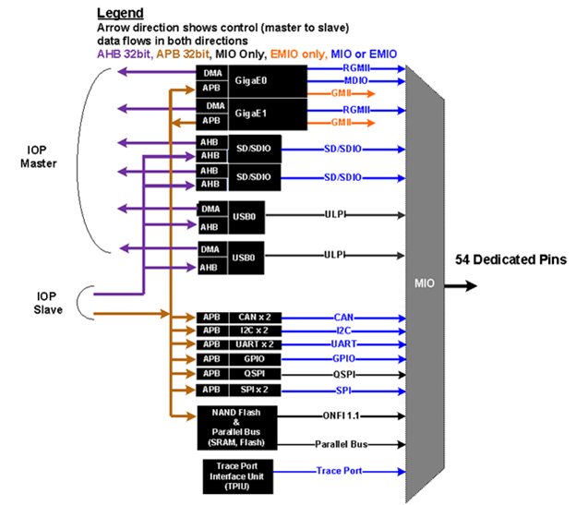
Input/Output Peripherals
Two GigE
Two USB
Two SPI
Two SD/SDIO
Two CAN
Two I2C
Two UART
Four 32-bit GPIOs
Static memories
NAND, NOR/SRAM, Quad SPI
Trace ports

Slide 21
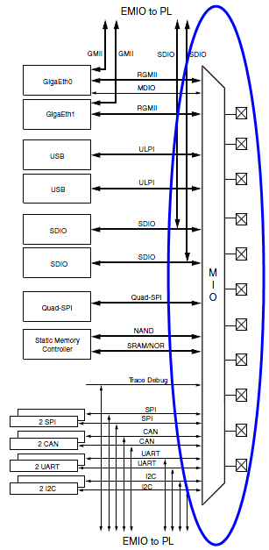
Multiplexed I/O (MIO)
External interface to PS I/O peripheral ports
54 dedicated package pins available
Software configurable
Automatically added to bootloader by tools
Not available for all peripheral ports
Some ports can only use EMIO

Slide 22
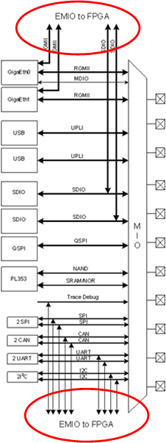
Extended Multiplexed I/O (EMIO)
Extended interface to PS I/O peripheral ports
EMIO: Peripheral port to programmable logic
Alternative to using MIO
Mandatory for some peripheral ports
Facilitates
Connection to peripheral in programmable logic
Use of general I/O pins to supplement MIO pin usage
Alleviates competition for MIO pin usage

Slide 23
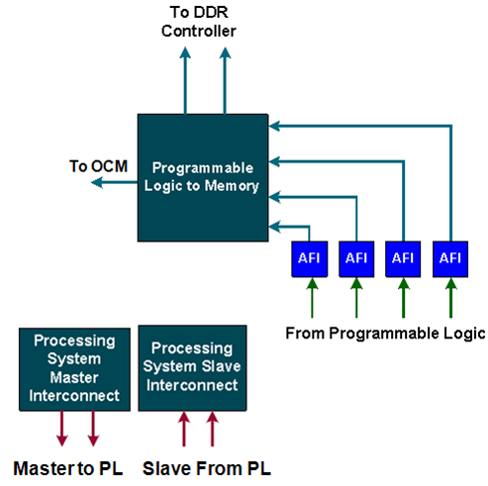
PS-PL Interfaces
AXI high-performance slave ports (HP0-HP3)
Configurable 32-bit or 64-bit data width
Access to OCM and DDR only
Conversion to processing system clock domain
AXI FIFO Interface (AFI) are FIFOs (1KB) to smooth large data transfers
AXI general-purpose ports (GP0-GP1)
Two masters from PS to PL
Two slaves from PL to PS
32-bit data width
Conversation and sync to processing system clock domain

Slide 24
PS-PL Interfaces
One 64-bit accelerator coherence port (ACP) AXI slave interface to CPU memory
DMA, interrupts, events signals
Processor event bus for signaling event information to the CPU
PL peripheral IP interrupts to the PS general interrupt controller (GIC)
Four DMA channel RDY/ACK signals
Extended multiplexed I/O (EMIO) allows PS peripheral ports access to PL logic and device I/O pins
Clock and resets
Four PS clock outputs to the PL with enable control
Four PS reset outputs to the PL
Configuration and miscellaneous

Slide 25
Outline
Zynq All Programmable SoC (AP SoC)
Zynq AP SoC Processing System (PS)
Processor Peripherals
Clock, Reset, and Debug Features
AXI Interfaces
Summary

Slide 26
PL Clocking Sources
PS clocks
PS clock source from external package pin
PS has three PLLs for clock generation
PS has four clock ports to PL
The PL has 7 series clocking resources
PL has a different clock source domain compared to the PS
The clock to PL can be sourced from external clock capable pins
Can use one of the four PS clocks as source
Synchronizing the clock between PL and PS is taken care of by the architecture of the PS
PL cannot supply clock source to PS

Slide 27
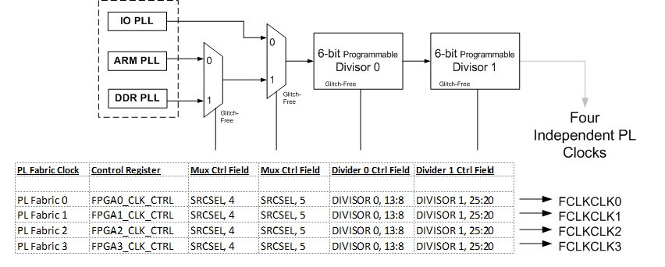
Clocking the PL

Slide 28
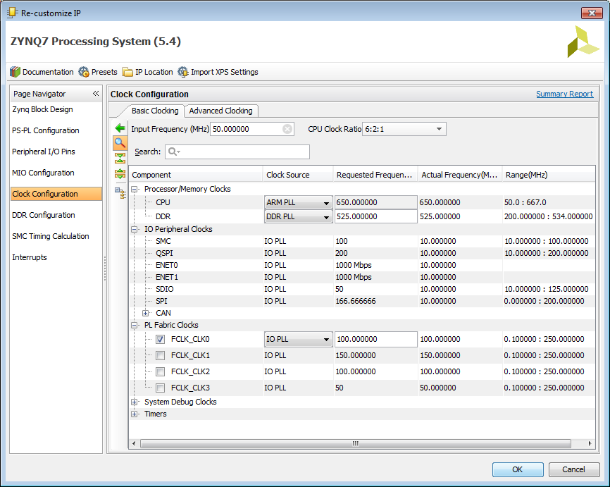
Clock Generation (Using Zynq Tab)
The Clock Generator allows configuration of PLL components for both the PS and PL
One input reference clock
Access GUI by clicking the Clock Generation Block, or select from Navigator
Configure the PS Peripheral Clock in the Zynq tab
PS uses a dedicated PLL clock
PS I/O peripherals use the I/O PLL clock and ARM PLL
Clock to PL is disabled if PS clocking is present

Slide 29
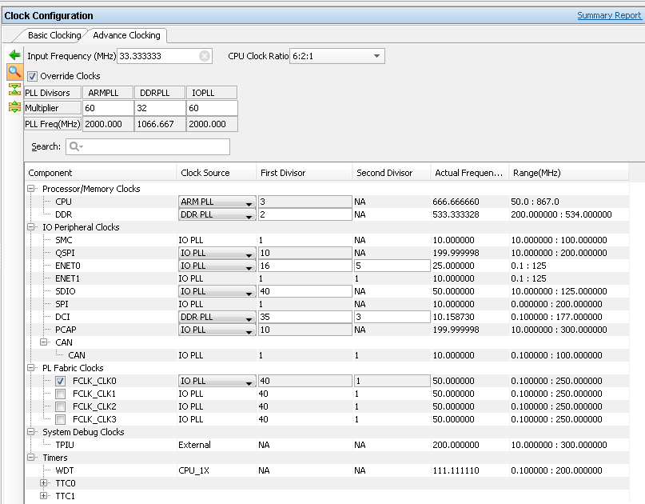
IP Integrator – Advanced Clocking in Zynq
Basic Clocking allows selection of desired frequency
Tools will auto calculate nearest achievable frequency
Advanced clocking allows access to clock multiply and divide values for various PLLs in the Zynq PS
Provides more control for user
Notes:
Users now have easier control over the multiply and divide values in the Zynq PS GUI.

Slide 30
Zynq Resets
Internal resets
Power-on reset (POR)
Watchdog resets from the three watchdog timers
Secure violation reset
PS resets
External reset: PS_SRST_B
Warm reset: SRSTB
PL resets
Four reset outputs from PS to PL
FCLK_RESET[3:0]

Slide 31
Outline
Zynq All Programmable SoC (AP SoC)
Zynq AP SoC Processing System (PS)
Processor Peripherals
Clock, Reset, and Debug Features
AXI Interfaces
Summary

Slide 32

AXI is Part of ARM’s AMBA
APB
AHB
AXI
AMBA
AMBA 3.0
(2003)
Older Performance Newer
AMBA: Advanced Microcontroller Bus Architecture
AXI: Advanced Extensible Interface

Slide 33
AXI is Part of AMBA
AMBA
APB
AHB
AXI
AXI-4
Memory Map
AXI-4
Stream
AXI-4
Lite
ATB
Enhancements for FPGAs
AMBA 3.0
(2003)
Same Spec
AMBA 4.0
(2010)
Interface | Features | Similar to
Memory Map / Full (AXI4) | Traditional Address/Data Burst (single address, multiple data) | PLBv46, PCI
Streaming (AXI4-Stream) | Data-Only, Burst | Local Link / DSP Interfaces / FIFO / FSL
Lite (AXI4-Lite) | Traditional Address/Data—No Burst (single address, single data) | PLBv46-single OPB

Slide 34
Basic AXI Signaling – 5 Channels
Read Address Channel
Read Data Channel
Write Address Channel
Write Data Channel
Write Response Channel
Notes:
AXI, at the highest level consists of the 5 channels shown.
Each channel is independent. And as you’ll see, whether its AXI4, AXI4-Lite or AXI4-Stream, the interfaces are effectively the same.

Slide 35
The AXI Interface—AX4-Lite
No burst
Data width 32 or 64 only
Xilinx IP only supports 32-bits
Very small footprint
Bridging to AXI4 handled automatically by AXI_Interconnect (if needed)
AXI4-Lite Read
AXI4-Lite Write
Notes:
AXI4-Lite is similar to AXI4 but only burst a signal data beat. There are some other features as well that allow this to be a very small footprint interface.

Slide 36
The AXI Interface—AXI4
Sometimes called “Full AXI” or “AXI Memory Mapped”
Not ARM-sanctioned names
Single address multiple data
Burst up to 256 data beats
Data Width parameterizable
1024 bits
AXI4 Read
AXI4 Write
Notes:
Whether you’re doing a read or write, an AXI4 transaction is the same. An address comes out, then the data is either written by the master or provided by the slave. The extra channel, Write Response, allows the slave to tell the master, in a write transaction, status on the transaction.
AXI4 can burst up to 256 data beats, the bit width of the Data depends on the design.

Slide 37
The AXI Interface—AXI4-Stream
No address channel, no read and write, always just master to slave
Effectively an AXI4 “write data” channel
Unlimited burst length
AXI4 max 256
AXI4-Lite does not burst
Virtually same signaling as AXI Data Channels
Protocol allows merging, packing, width conversion
Supports sparse, continuous, aligned, unaligned streams
AXI4-Stream Transfer
Notes:
AXI4-Stream is somewhat different from AXI4 and AXI4-Lite. It is much like a single “Write Data” channel. In addition, there is no limit to the size of the burst on an AXI4-Stream channel.

Slide 38
Streaming Applications
May not have packets
E.g. Digital up converter
No concept of address
Free-running data (in this case)
In this situation, AXI4-Stream would optimize to a very simple interface
May have packets
E.g. PCIe
Their packets may contain different information
Typically bridge logic of some sort is needed

Slide 39
Outline
Zynq All Programmable SoC (AP SoC)
Zynq AP SoC Processing System (PS)
Processor Peripherals
Clock, Reset, and Debug Features
AXI Interfaces
Summary

Slide 40
Summary
The Zynq-7000 processing platform is a system on a chip (SoC) processor with embedded programmable logic
The processing system (PS) is the hard silicon dual core consisting of
APU and list components
Two Cortex-A9 processors
NEON co-processor
General interrupt controller (GIC)
General and watchdog timers
I/O peripherals
External memory interfaces

Slide 41
Summary
The programmable logic (PL) consists of 7 series devices
AXI is an interface providing high performance through point-to-point connection
AXI has separate, independent read and write interfaces implemented with channels
The AXI4 interface offers improvements over AXI3 and defines
Full AXI memory mapped
AXI Lite
AXI Stream
Tightly coupled AXI ports interface the PL and PS for maximum performance
The PS boots from a selection of external memory devices
The PL is configured by and after the PS boots
The PS provides clocking resources to the PL
The PL may not provide clocking to the PS

